Slide 1
Non-Conventional Energy Resources

Slide 2
Non-Conventional Energy Resources
Unit-II
Solar Thermal Energy: Solar radiation, flat plate collectors and their materials, applications and performance, focusing of collectors, solar thermal power plants, thermal energy storage for solar heating and cooling, limitations.

Slide 3
Solar Radiation
The solar radiations received by the earth’s
surface depends on various factors, like location,
weather conditions, climate,
absorption, reflection, scattering and attenuation by aerosol, particulates present in the atmosphere.
The solar radiation may be explained in two categories:
Extraterrestrial Solar Radiation
Terrestrial Solar Radiation

Slide 4
Extraterrestrial Solar Radiation
The intensity
of sun’s
radiation
outside the
earth’s atmosphere
is called extraterrestrial
radiation. It has no diffuse components. The radiations are measured as an average earth-sun distance on a surface normal to radiation.
The energy flux is called solar radiation and may be defined as
– The energy received from the sun per unit time on a unit area of surface, perpendicular to the direction of propagation of the radiation at the earth’s mean distance from the sun outside the atmosphere.”

Slide 5
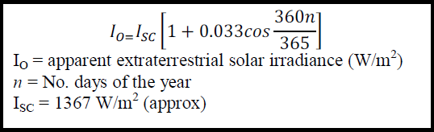
Extraterrestrial Solar Radiation
It is denoted by ISC and is estimated as1367 W/m2.
The value of solar constant remains constant throughout the year.
Its value changes with location.
The extraterrestrial radiation observed on different days is known as apparent extraterrestrial solar radiation (irradiance) and can be calculated on any day of year with given equation:

Slide 6
Terrestrial Solar Radiation
The radiations receive on the earth surface is called the terrestrial radiation and is nearly 70% of extraterrestrial solar radiation. Its maximum value on horizontal earth surface is 1000 W/m2, because a large part of radiations are absorbed, reflected, attenuated back by earth’s atmosphere.

Slide 7
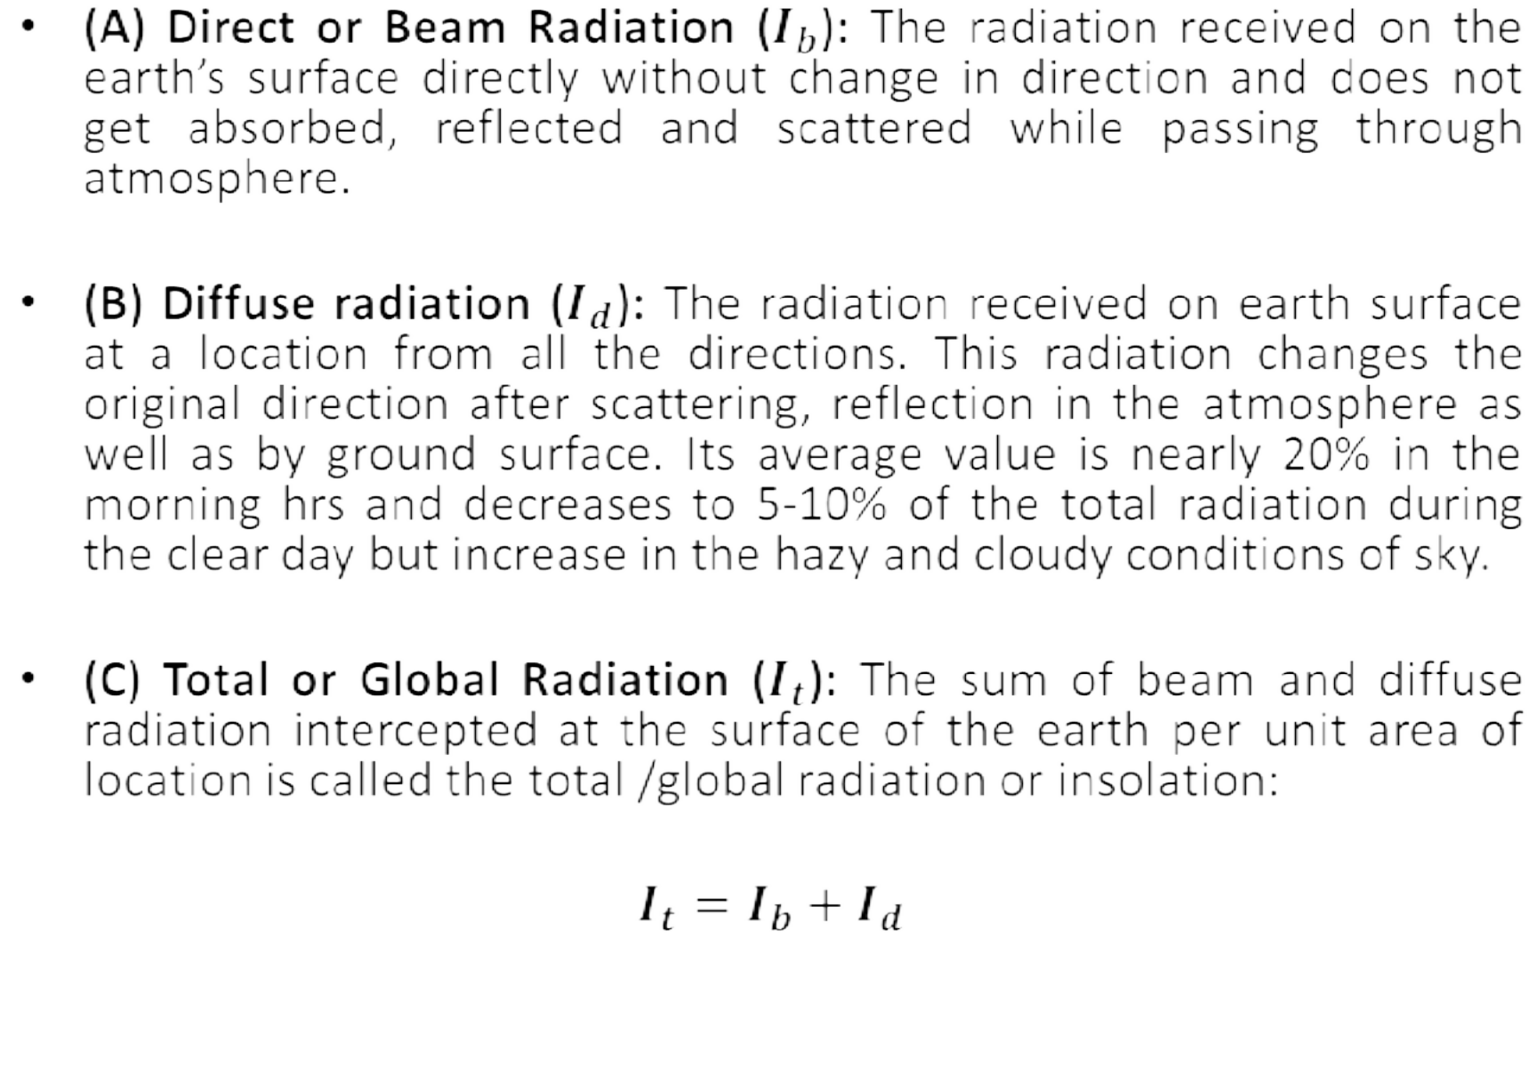
Types of Solar Radiations

Slide 8
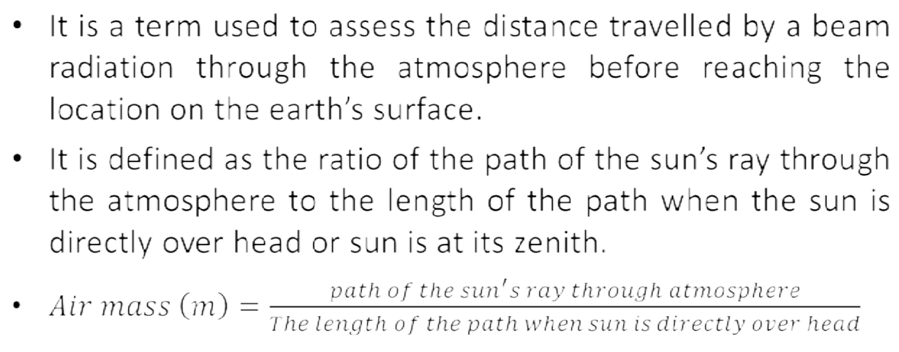
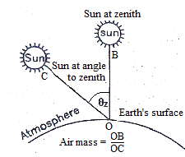
Air Mass

Slide 9
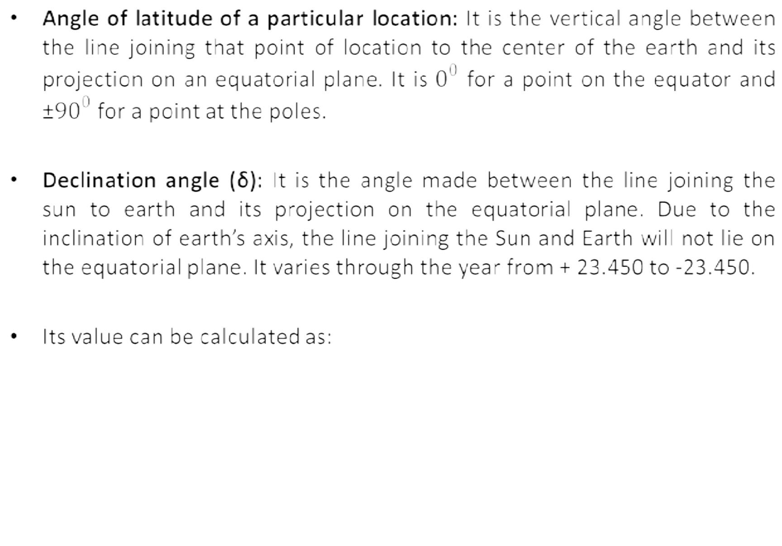
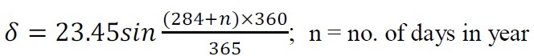
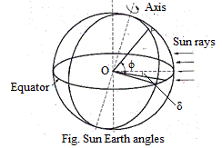
Basic Sun-Earth Angles

Slide 10
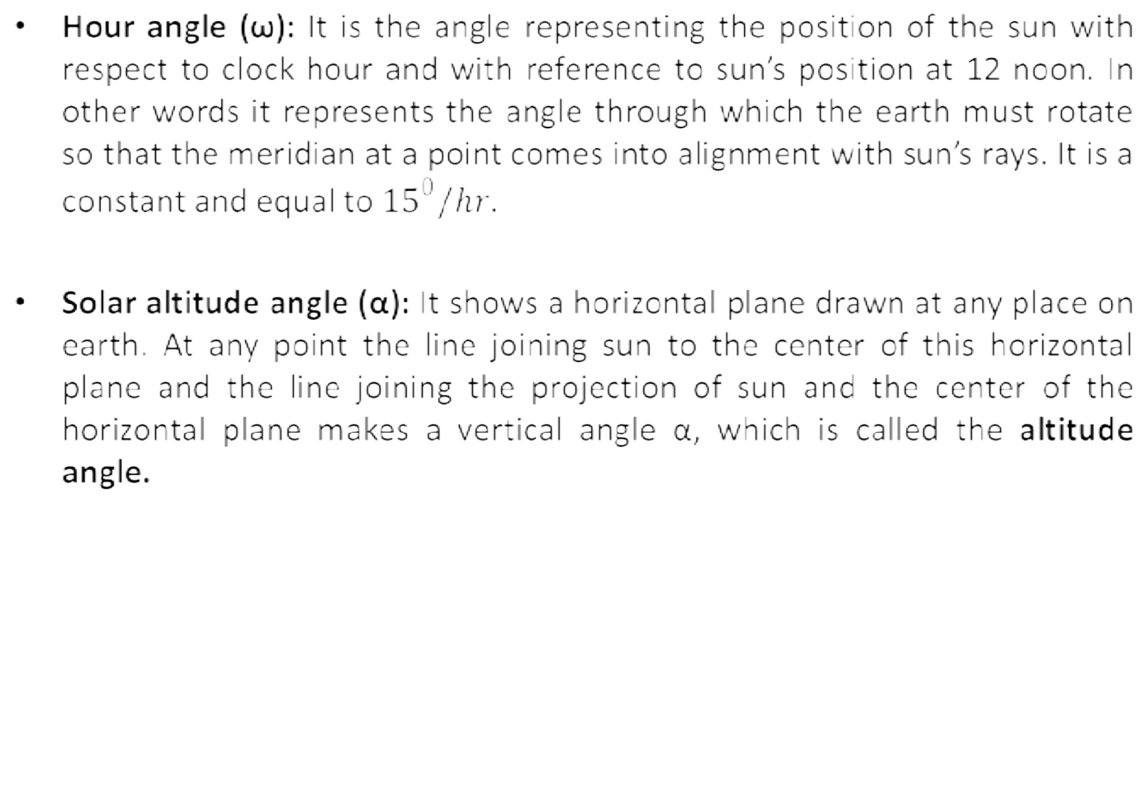
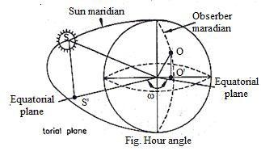
Basic Sun-Earth Angles

Slide 11
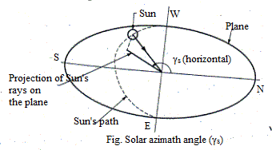
Basic Sun-Earth Angles
Zenith angle (θZ): If a vertical line is drawn to this horizontal plane, at its center, the line joining sun and the center of the plane will make an angle θZ with this vertical. This angle is called the zenith angle.
Local solar time (LST): This is also called Local Apparent Time (LAT) td calculated using various values of θZ. The time so calculated the Local Solar Time. This will vary from the actual clock time by approximately 4 minutes. This variation changes with the month of the year.

Slide 12
Solar Thermal Energy
The application of solar thermal energy ranges from solar cooker of 1 kW to power plant of 200 MW.
These systems are grouped into
low temperature (< 1500C)
medium temperature (1500 - 3000C)
high temperature (5000 –10000C).

Slide 13
Solar Collectors
Solar collectors are used to collect the solar energy and convert the incident radiations in thermal energy by absorbing them.
This heat is absorbed by flowing fluid in the tube of collector.
These are of two types:
Non concentrating collectors
Concentrating collectors

Slide 14
Non concentrating collectors
Non concentrating collectors: In these collectors the area of collector to intercept the solar radiation is equal to the absorber plate and has concentration ratio of 1. These can be categorized as:
Flat Plate Collectors
Vacuum Tube Collectors
Unglazed Flat Plate Collectors

Slide 15
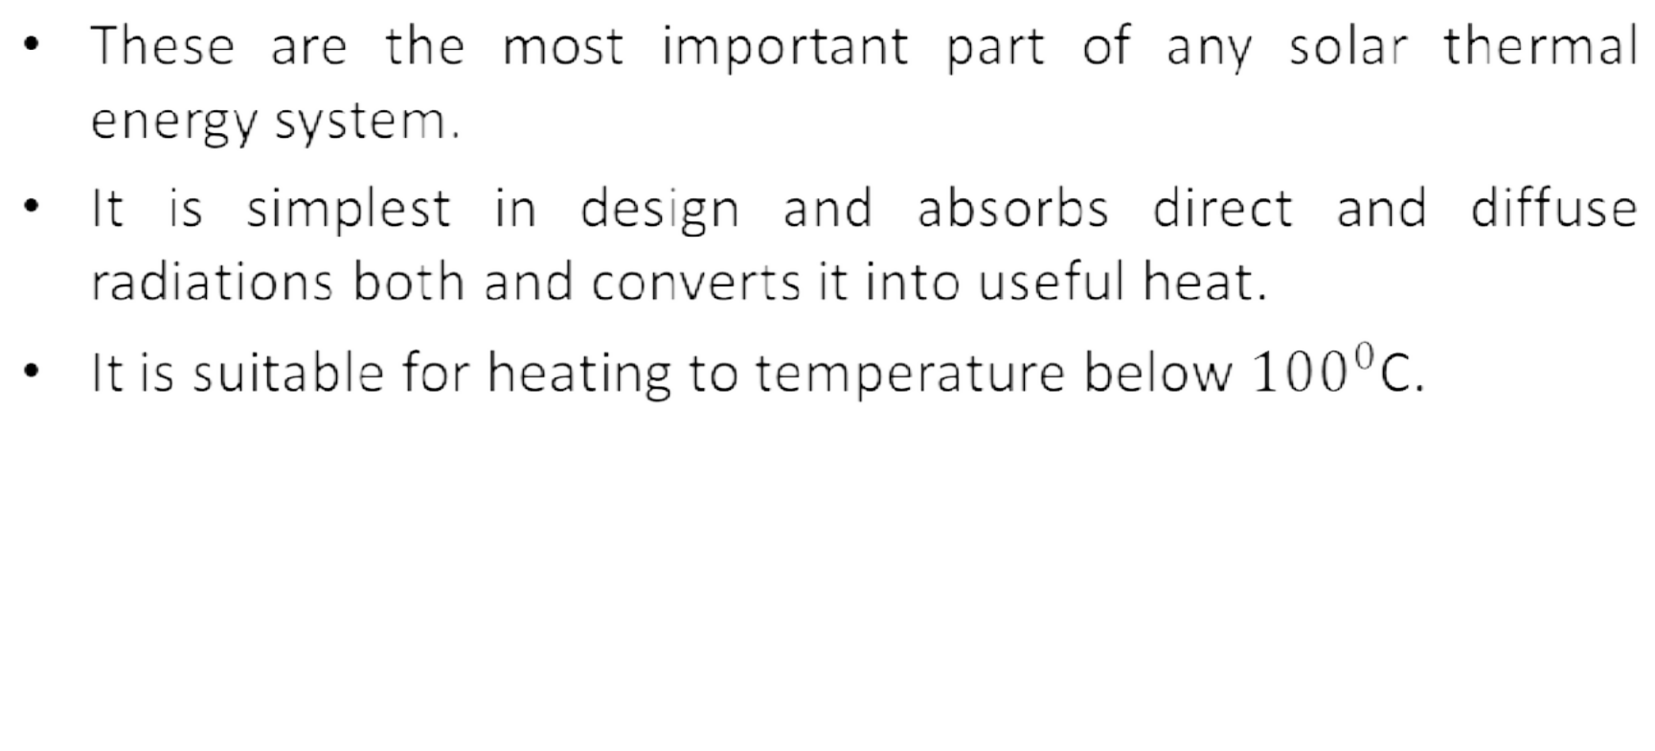
Flat Plate Collectors

Slide 16
Flat Plate Collectors
Advantages
Utilizes the both the beam as well as diffuse radiation for heating
Less maintenance requires
Low water temperature is achieved.

Slide 17
Flat Plate Collectors
Advantages
Utilizes the both the beam as well as diffuse radiation for heating
Less maintenance requires
Low water temperature is achieved.
Disadvantages
Large heat losses by conduction and radiation.
No tracking of sun.
Low water temperature is achieved.

Slide 18
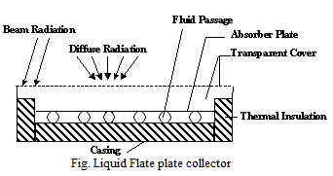
Flat Plate Collectors
Advantages
Utilizes the both the beam as well as diffuse radiation for heating
Less maintenance requires
Low water temperature is achieved.
Disadvantages
Large heat losses by conduction and radiation.
No tracking of sun.
Low water temperature is achieved.

Slide 19
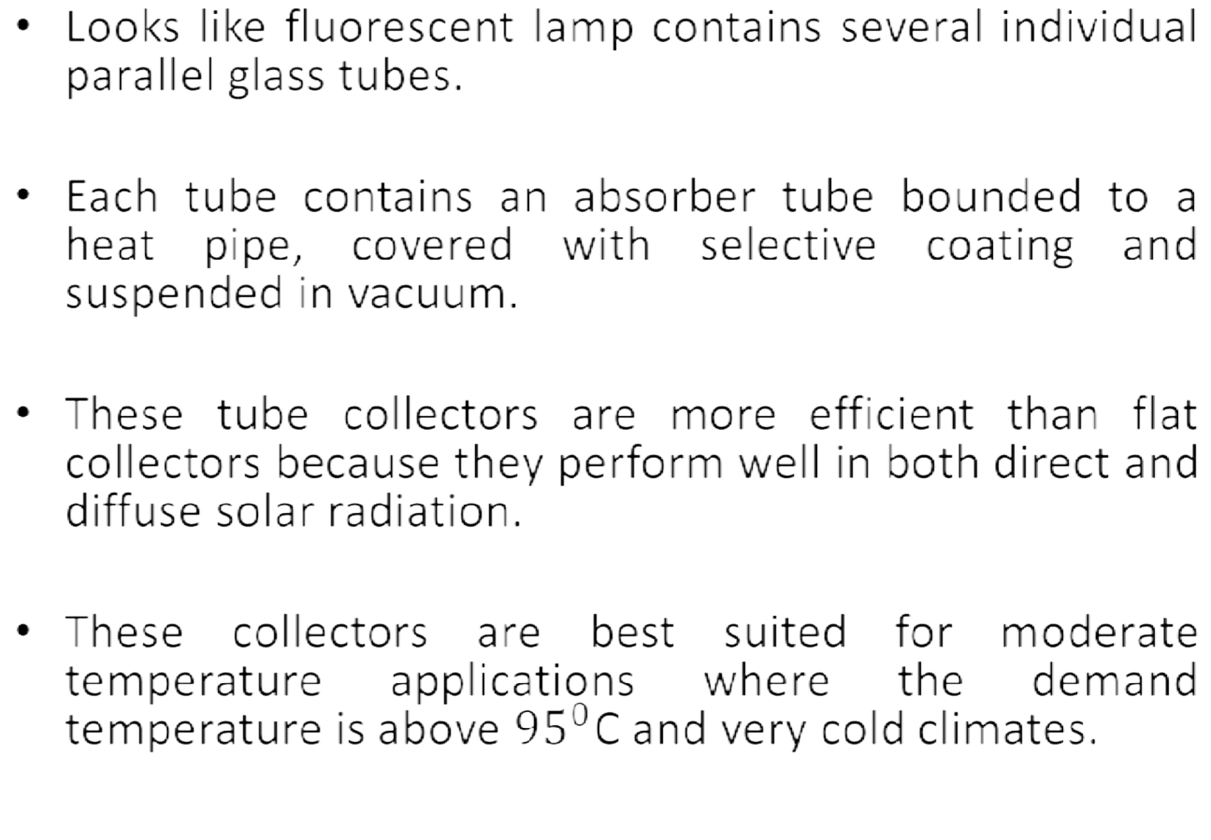
Vacuum Tube Collectors

Slide 20
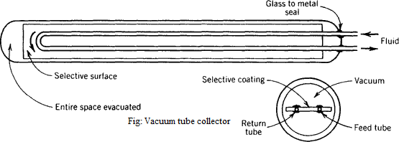
Vacuum Tube Collectors

Slide 21
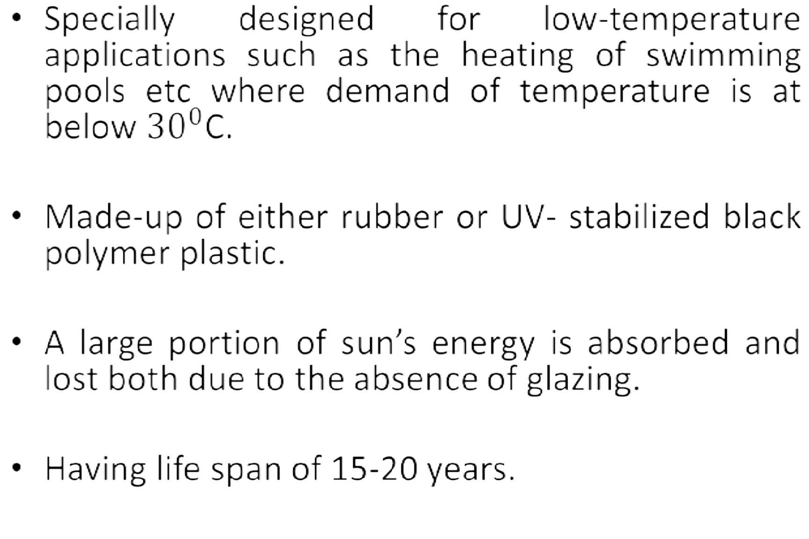
Unglazed Flat Plate Collectors

Slide 22
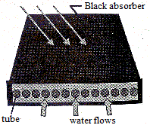
Unglazed Flat Plate Collectors

Slide 23
Non concentrating collectors
These can be categorized as:
Flat Plate Collectors
Vacuum Tube Collectors
Unglazed Flat Plate Collectors
As discussed in previous slides.

Slide 24
Construction and Materials for Flat Plate Collectors
Material needed for flat plate collectors can be classified into following groups:
Physical properties – tensile strength, density etc.
Thermal properties – thermal conductivity, heat capacity etc.
Environmental properties – corrosion resistant, degradation of material due to UV radiation, moisture penetration etc.
The materials generally used for various components of a flat plate
collector are as given below:
(a) Absorber Plate and Tubes:
(b) Thermal Insulation:
(c) Transparent Cover Plates:
(d) Casing:
(e) Selective Coating:

Slide 25
Materials for Flat Plate Collectors
(a) Absorber Plate and Tubes:
– These plates should have high tensile strength; high thermal conductivity and it should be corrosion resistant (generally made of copper, aluminum, steel etc).
– Generally black chrome, black copper oxides,
having
black high
nickel etc are used absorptivity.
(b) Thermal Insulation:
– The material used
for its coating to
for insulation should have low
thermal conductivity, stability at high temperature up to 2000C, non-corrosive.
– Insulating materials generally used are mineral wool, rock wool, glass, thermo Cole, foam etc.

Slide 26
Materials for Flat Plate Collectors
(c) Transparent Cover Plates:
Cover plates must have high strength, high solar energy transmittance and high durability against UV radiation.
Usually plain glass plates or toughened of 4 to 5 mm thickness are used.
(d) Casing:
This contains all the above components which is placed at an angle facing south at an inclination to the horizontal equal to the latitude of the place plus 150.
It is made of aluminum, steel or fiber glass in rectangular shape.

Slide 27
Materials for Flat Plate Collectors
(e) Selective Coating:
This surface has high absorptivity of incoming solar radiation and low value of emissivity.
Selective surfaces are essential to reduce the heat losses from absorber plate and increase the temperature of absorbing surface i.e. it should have high collector efficiency.
Various methods of these coatings which are employed are by electroplating, anodic oxidation, chemical conversion etc.
Generally Black chrome, black nickel, aluminum nitride etc are used for this purpose.

Slide 28
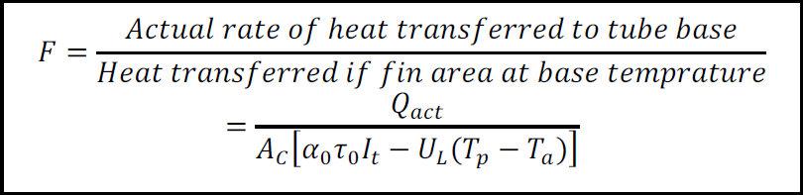
Performance of Flat Plate Collectors:
Fin Efficiency Factor (F)
It indicates the effectiveness of a fin in transferring the thermal energy to the tube from the projected plane.
It is defined as a ratio of actual heat transferred to the heat that would be transferred if entire plate area (fins) is at base temperature. It is represented by letter F.
Where: Qact = actual rate of heat transferred to tube base (W/m2)
Ac= collector area (m2); It = incident total radiations (W/m2); UL = overall heat loss coefficient (W/m2 0C); Tp= plate temperature (0C); Ta = ambient temperature (0C); α0τ0 = product of absorptivity and transmitivity; α0τ0I0 = heat energy absorbed by collector / area (W/m2); UL(Tp - Ta) = overall heat loss / area (W/m2).

Slide 29
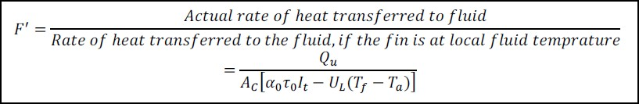
Performance of Flat Plate Collectors:
Collector Efficiency Factor (F’)
It is defined as the ratio of useful heat removed by flowing fluid in the tubes to the heat removed with assumption that collector absorbing plate is at local fluid temperature (Tf) throughout.
This factor is constant for given collectors and depends on design and flow rate of fluid through tubes.
Decreases with increase in spacing between the tubes and increases with thermal conductivity of material and its thickness.

Slide 30
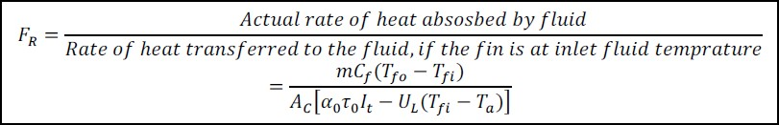
Performance of Flat Plate Collectors:
Collector Heat Removal Factor (FR)
It is defined as a ratio of actual useful energy gain by fluid to the energy gain if the entire collector is at fluid inlet temperature.
It reduces the actual useful heat gain by flowing fluid in the tube.
Where: Tfo= outlet fluid temperature; Tfi= inlet fluid temperature (0C); m = mass flow rate of fluid (Kg/s); Cf = specific heat capacity of fluid (KJ/Kg K).

Slide 31
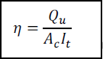
Performance of Flat Plate Collectors:
Collector Efficiency (η)
It is the ratio of useful energy absorbed by collector to the incident solar energy over it

Slide 32
Factor Affecting the Performance of Flat Plate Collectors:
Incident Solar Radiation: As the solar flux increases, the heat absorbed by the collector increases, thereby the performance of the collectors improves.
Selective Surfaces: By using materials for surfaces which are highly sensitivity to the radiation, the absorption could be maximized. The selective surface should be able to withstand high temperature of 300-4000C should not oxidize and be non-corrosive.
Number of Cover Plates: The increase in number of cover plate reduces the internal convective heat losses but also prevents the transmission of radiation inside the collector. More than two cover plate should not be used to optimize the system.
Collector Tilt: The flat plate collectors do not track sun and should be tilted at angle latitude of the location for an average better performance. The collector is placed with south facing at northern hemisphere to receive maximum radiation throughout the day.

Slide 33
Factor Affecting the Performance of Flat Plate Collectors:
Spacing between Absorber Plates and Glass Cover: The more space between the absorber and cover plate the less internal heat losses. The collector efficiency will be increased. However on the other hand, increase in space between them provides the shading by side wall in the morning and evening and reduces the absorbed solar flux.
Fluid Inlet Temperature: As the inlet temperature of the fluid increases, the operating temperature of the collector increases. This lead to increased losses and decrease in efficiency.
Dust on Cover Plate: The efficiency of collector decreases with dust particles on the cover plate because the transmission radiation decreases by 1%. Frequent cleaning is required to get the maximum efficiency of collector.

Slide 34
Concentrating Type Collectors
These types of collectors are also known as focusing collectors.
These are used for medium (100-3000C) and high temperature (above 3000C) application such as steam production for the generation of electricity.
The collector system comprises of a concentrator and absorber (receiver). The concentrator is an optical system in the form of reflecting mirrors or reflecting lenses.
The collector is installed with a tracking device for continuously following the sun.
The receiver includes an energy absorbing surface, transparent cover and other accessories.
The system receives the solar radiation on the large concentration area and focused it on to a an absorber having relatively much lesser area.
These systems have high collector efficiency which lies between 50- 70%.

Slide 35
Types of Solar Concentrating Collectors
These are further divided into two categories
Focusing type or concentrating type collectors
Non-focusing type collectors
Focusing Type Concentrator:
Parabolic trough reflector
Mirror strip reflector,
Fresnel lens collector
Parabolic dish collector
Non-Focusing Type Collectors:
Flat plate collector with plane reflector
Compound parabolic concentrator

Slide 36
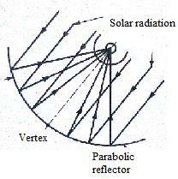
Parabolic Trough Reflector
This type is line focusing type collector.
In this type of collector, the solar radiations falling on the area of the parabolic reflector are concentrated at the focus of parabola.
These are usually made of highly polished or glass like shine
surfaces.
The temperature at the absorber tube is obtained at nearly 4000C.
Because of its parabolic shape, it can focus the sun at 30 to 100
times its normal intensity on a receiver.

Slide 37
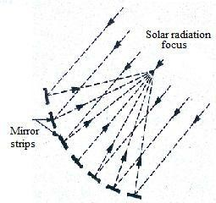
Mirror Strip Reflector Type Concentrating Collector
It has the plane or slightly curved mirror strips mounted on a flat base.
The individual mirrors are placed at such an angle that reflected solar radiations fall on the same focal line where the absorber pipe is placed.
The collector pipe is rotated so that the reflected rays on the absorber remain focused with respect to changes n sun’s elevation.

Slide 38
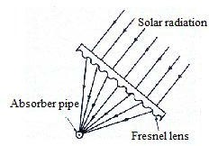
Fresnel Lens Concentrating Collector
In this collector a Fresnel lens which consists of fine, linear grooves on the surface of refracting material of optical quality on one side and flat on the other side is used.
The solar radiations which fall normal to the lens are refracted by the lens and are focused on a line where the absorber (receiver) tube is placed.
A Fresnel lens collector is generally made of acrylic plastic sheets having overall dimensions of 4.7 m × 0.05 m.

Slide 39
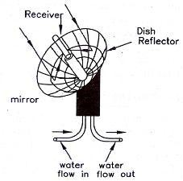
Parabolic Dish Collector
It is point focusing type collector which have a mirror like reflectors and an absorber at the focal point.
The concentrating ratio of these collectors is 100 and temperature
of the receiver can reach up to 20000C.
These collectors have higher efficiency for converting solar energy to electricity in the small-power plant.

Slide 40
Types of Solar Concentrating Collectors
These are further divided into two categories
Focusing type or concentrating type collectors
Non-focusing type collectors
Focusing Type Concentrator:
Parabolic trough reflector
Mirror strip reflector,
Fresnel lens collector
Parabolic dish collector
Non-Focusing Type Collectors:
Flat plate collector with plane reflector
Compound parabolic concentrator

Slide 41
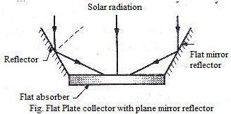
Flat Plate Collector with Plane Reflector
It uses a flat plate collector with plane mirror reflector attached on its edges to reflect the additional solar radiations into the receiver, thus the total solar radiation received by the receiver are increased. The mirrors used are called booster mirrors.
These collectors utilize direct and diffuse both types of radiations and achieved fluid temperature higher by 300C than in FPC.

Slide 42
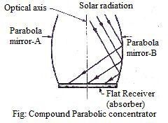
Compound Parabolic Concentrator (CPC)
It is also called Winston collectors. It consists of two facing parabolic mirror segments attached to a flat receiver (absorber).
It collects both direct and diffuse solar radiation with high acceptance angle and requires occasional sun tracking.
The temperature attained is in the range from 1000C to 1500C. However temperature up to 2000C can be achieved using evacuated type of tubular absorber.

Slide 43
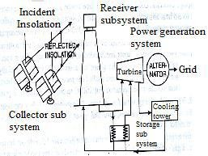
Center Receiver Type (Solar Power Tower):
There is one more type of solar collectors, known as solar power tower.
This system uses 100-1000 of flat tracking mirrors called heliostats to reflect the large solar energy at one point (receiver).
Each heliostat is rotated into two directions so as to track the sun and they together behave like a broken very large parabolic reflector.
A concentration ratio up to 3000 can be achieved with this system and capable to generate steam of high pressure and high temperature suited for generation of electricity in steam power plants.

Slide 44
Advantages of concentrating Collectors Over Flat Plate Collectors:
Cost of concentrator system/unit area is less.
Requires less absorber area.
Has high collection efficiency since heat losses are less.
Suitable for large power generation since high temperatures of the fluid can be attained.

Slide 45
Disadvantages of concentrating Collectors Over Flat Plate Collectors:
System needs tracking of sun which increases the capital cost.
Diffuse solar radiations cannot be collected on receiver.
Requires higher maintenance to retain the quality of reflecting surfaces.
Has high initial cost and maintenance cost.

Slide 46
Solar Thermal System
A solar thermal system is use to convert solar energy into other forms of energy which may be utilized for various applications like:
Heating water for domestic use and for swimming pools;
Heating and cooling of buildings;
Day lighting of buildings;
Cooking food;
Solar distillation (water treatment etc);
Electricity generation;
Powering earth satellites etc.

Slide 47
Solar Thermal Power plant:
A solar power plant converts solar energy into electrical energy. They can be divided into following categories:
Low temperature solar power plant using flat plate collectors
Medium temperature solar power plant using concentrated solar collectors
High temperature solar power plant using tower system.

Slide 48
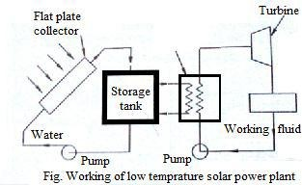
Low Temperature Solar Power System
The low temperature solar power plants uses the working fluid temperatures in the range of 600C to 1000C which can be obtained using flat plate collectors.
Since the water can be only heated 800C in FPC, the systems needs to use a working fluid having low boiling temperature like butane gas.

Slide 49
The cold water is circulated into the collector with the help of a
circulating pump.
The heated water is circulated in a heat exchanger called butane boiler, where it generates the butane gas at high pressure. This butane gas supplied to a butane turbine to produce mechanical power due to expansion of butane gas.
The vapour coming out of the turbine is condensed in a condenser and sent back for recirculation with the help of feed pump.
The mechanical power output of turbine is converted into electric power by generator.

Slide 50
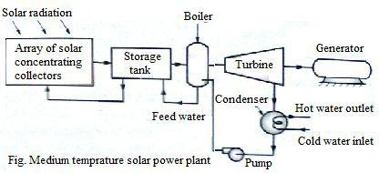
Medium temperature Solar Power Plant
These systems employ an array of parabolic through concentrating collectors spread over a large area.
The general range of working temperature is between 2500C to 4000C.

Slide 51
The working fluid, usually water, is heated as it circulates through the receivers.
This heat is transferred to storage tank and fed to water where the
steam is generated in the steam generator.
This steam is utilized to run a turbine coupled to a electric generator, which converts it into electrical energy by electro-mechanical energy conversion.
The exhaust of steam turbine is condensed in the condenser with the help of cold water circulated in the condenser.
A 30 MW plant have been installed in Rajasthan under the department of non-conventional energy sources.

Slide 52
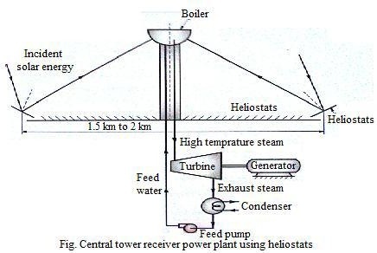
High Temperature Solar Thermal Power Plants
Such plants use heliostat sand have high thermal efficiency, can
build in the capacity of 50 MW to 200 MW.

Slide 53
The solar dish collectors receive solar radiations which are collected at a common focusing point. Small volumes of the fluid are heated at this point high temperature.
In central tower receiver an array of plane mirrors called heliostats which are individually controlled and tracked to reflect the solar radiations on a receiver kept on a tower of about 500 m height.
The feed water in the absorber-receiver called boiler is converted into high steam of about6000C- 7000C.
This steam is supplied in a conventional steam power plant
coupled to an electric generator to generator electrical power.

Slide 54
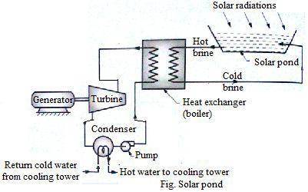
Solar Pond
The concept of solar pond is based on the observation that some natural lakes have higher temperature at bottom where salt concentration is higher.

Slide 55
The heat of hot brine solution from solar pond is used to evaporated the working substance at constant pressure in the boiler.
This vapour is used to run the vapour turbine to produce mechanical power is utilized to run a generator to produce the electrical power.
The exhaust of the turbine is condensed in the condenser at
constant pressure with the help of cooling water.
The condensate is returned to the boiler by a pump. Thus the cycle is repeated.

Slide 56
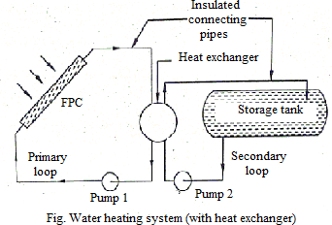
Solar Water Heater
The solar water heaters are used to raise the temperature of water and store it for various purposes as when needed.

Slide 57
It consists of the following main components connected with the help of
insulated piping:
(i) Flat plate collector
(iii) Heat exchanger
(ii) Storage tank
(iv) Pump
The water is heated in the flat plate collectors. The low temperature water is fed from bottom side of collector and high temperature water is taken out from the top of the collector.
The storage tank is insulated to retain the heat of water with minimum losses. The heated water is stored in the tank for further use.
The heat exchanger is incorporated between the collector and storage tank. It is installed and good quality of water is used in primary cycle of the collector.
Pumps are used for circulation of fluid.

Slide 58
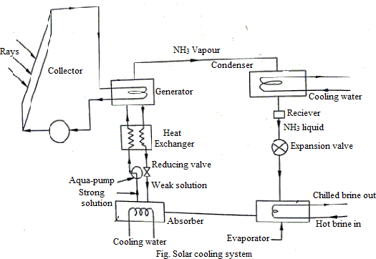
Solar Cooling System

Slide 59
The cycle used for cooling with utilization of solar energy is vapour absorption cycle is used in remote area having scarcity of power.
The performance of vapour absorption system depends upon the working fluid pair i.e. refrigerant and absorbent.
The absorption systems are classified as:
(a)Ammonia/water absorption system (b)Ammonia/water/hydrogen Electrolux absorption system (c)Lithium bromide (Libr)/water absorption system.
Simple Ammonia/Water Absorption System
The most commonly used refrigerant in absorption system is ammonia. It is cheap and readily available and has great affinity with water is used as absorbent and absorbs NH3 very fast.
The ammonia-water absorption system is used for cooling duties up to
-500C. The heat required in generator is supplied by water heated in FPC.
Its main components and their working can be explained as:

Slide 60
Its main components and their working can be explained as:
The Absorber: The absorber acts as a suction pump. The water is used as absorbent to absorb the low-pressure suction vapour of NH3 coming out of evaporator. During absorption the ammonia discharges its latent heat of condensation to the water which raises its temperature. Thus it is always desirable to cool the absorbent solution by cooled circulated external water or by means to keep the absorbent temperature as low as possible.
Pump: The NH3 rich solution from the absorber is pumped to the generator by means of using small capacity pump. The pump raises the pressure of mixture.
Generator: The heat from collector is supplied to the generator to boil off
the rich mixture of NH3/water.

Slide 61
Pressure Reducing Valve: The weak solution left in the generator at condensed pressure is returned back to absorber through pressure reducing valve. The pressure reduces from condenser pressure to absorber pressure.
Condenser: The high pressure ammonia vapour leaving the generator gets
condensed in water-cooled condenser.
Expansion Device: The condensed liquid ammonia from condenser is supplied through expansion device to evaporator. The Expansion device lower the pressure and temperature of liquid ammonia.
Evaporator: Low temperature and low pressure liquid ammonia enters in the evaporator where it boils of by absorbing latent heat from surrounding to produce refrigeration effect. The liquid NH3 changes to low pressure suction vapour. The suction vapour is absorbed in absorber to maintain the continue circulation of NH3 in system.

Slide 62
END OF UNIT 2

